Slide 1
River Flows and Sediment Movement

Slide 2
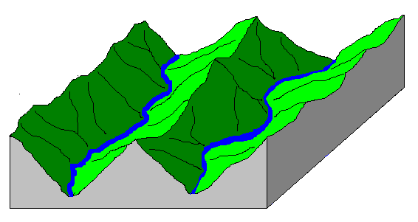
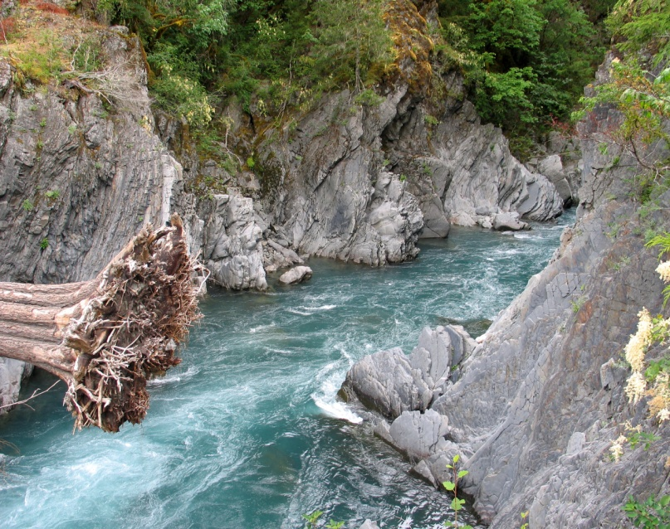
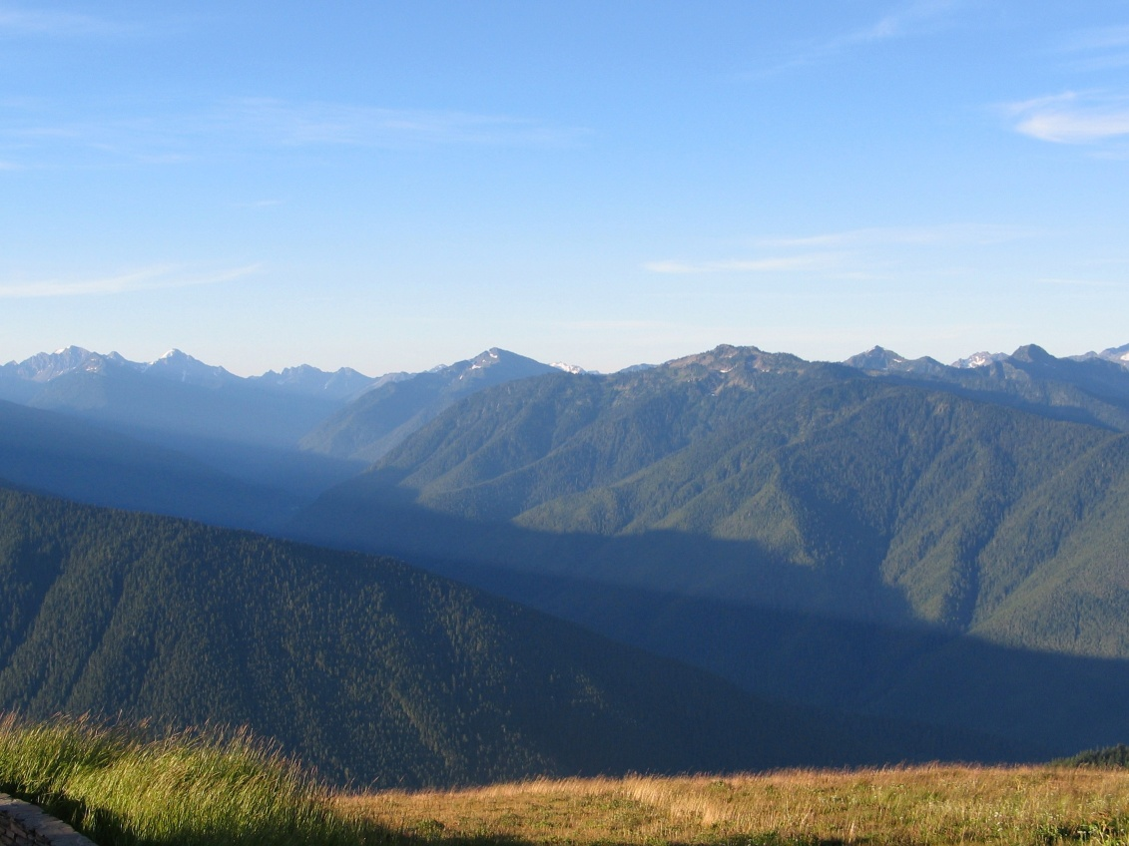
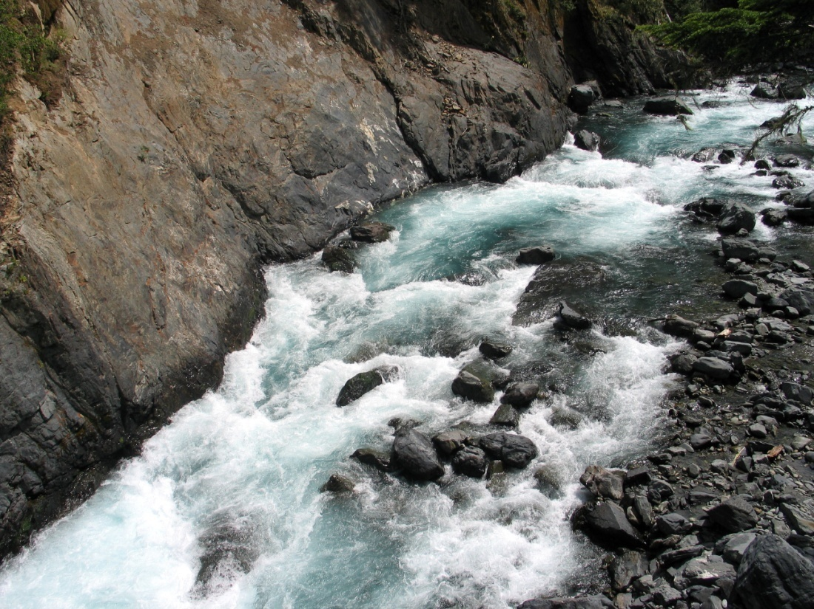
Fast-Flowing Rivers and V-shaped Valleys
Notes:
Fast-flowing rivers erode a river bed by picking up rocks and tumbling them downstream. As they move, they scrape at the bottom and loosen more rocks, which are also plucked off the bottom. As the river eats into the bed rock, it forms narrow gorges. However, the steeper the gorge, the more likely erosion from above will cause rocks to fall into the gorge and eventually sides of the gorge will erode back to form a V-shaped valley.
The image at top-right shows the fast-flowing Elwha river eating into bedrock to form a gorge at Goblins Gate. Lower-right shows the Grand Canyon of the Elwha forming a similar formation. The V-shaped valley of the Elwha watershed is in the lower-left.

Slide 3
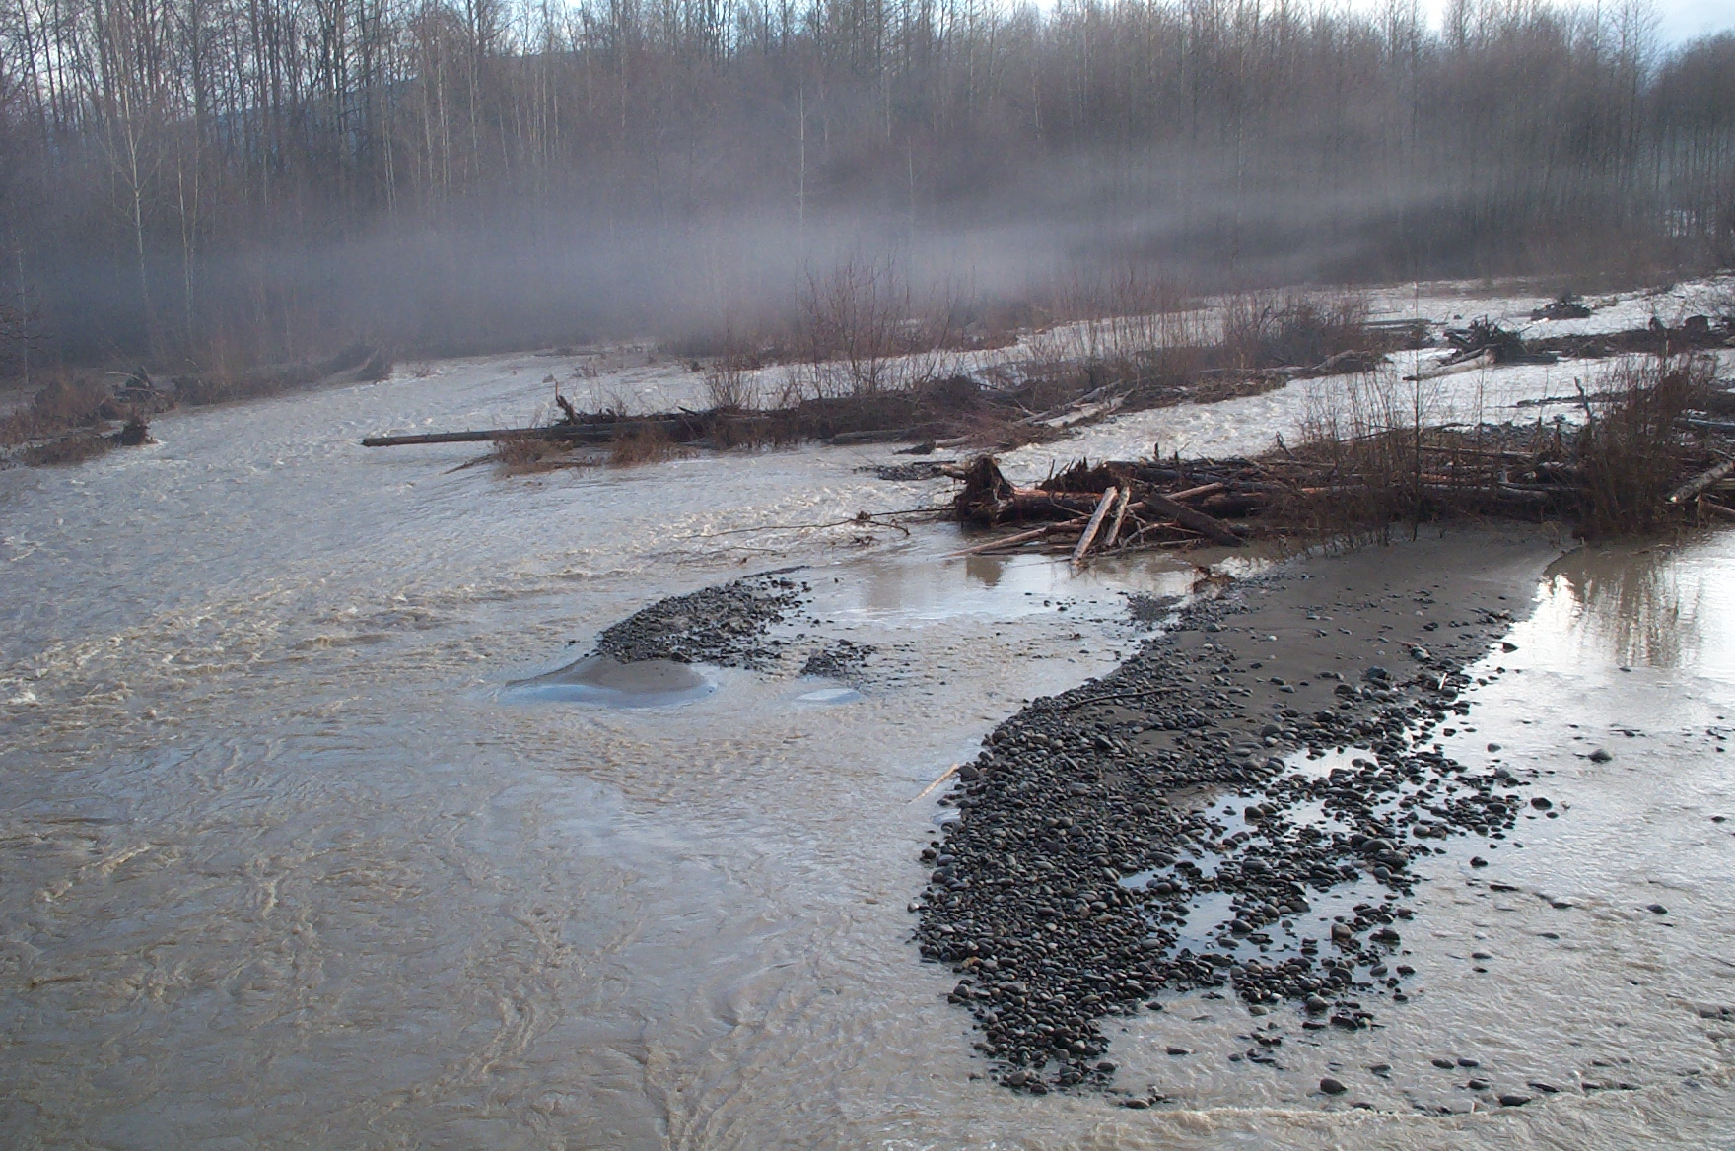
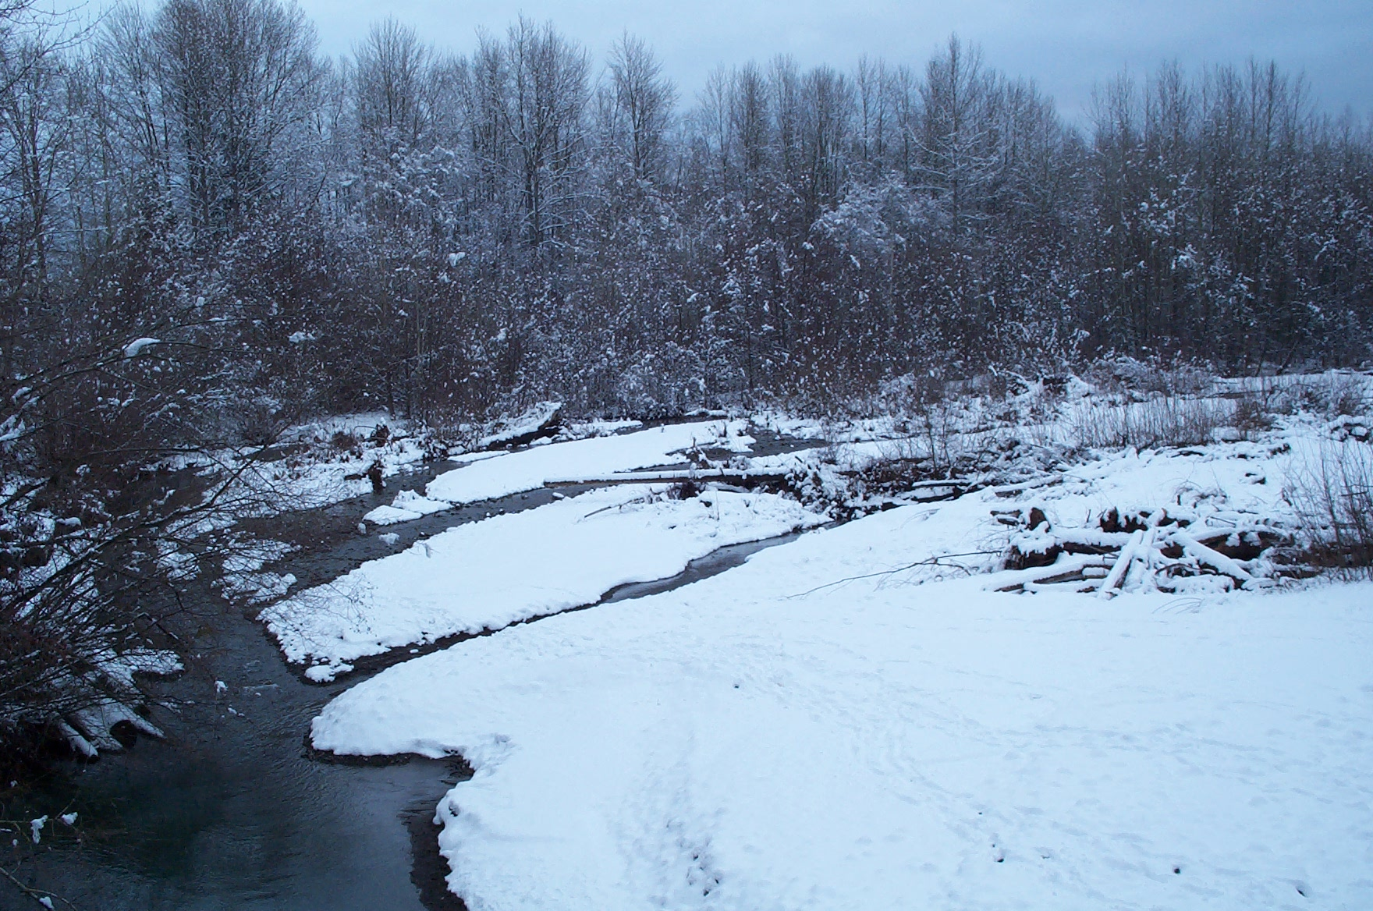
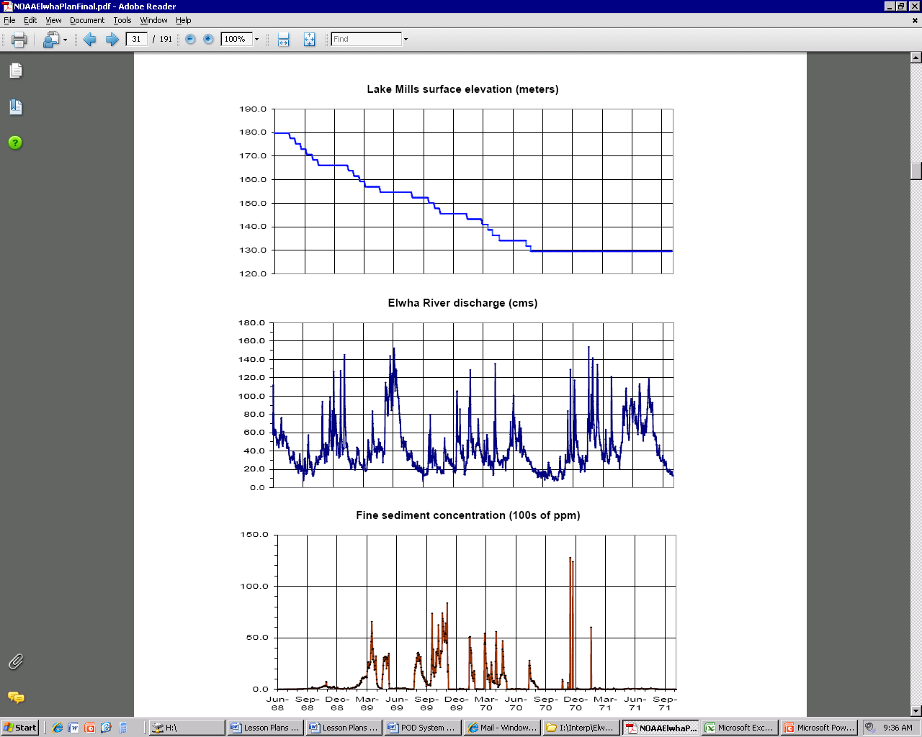
Seasonal Flow Levels
Snow pack is melting
Fall rains return
Spring rains return
Precipitation is trapped as snow
Snow pack is gone and long summer drought
Notes:
Most rivers have normal seasonal flow patterns based upon when and how much water enters the system. For rivers in the Pacific Northwest, the flow patterns can be erratic based on storms, but with some predictable seasonal patterns. Typically there are very low flows in late summer, after the snow pack has melted away and at the end of the long summer drought. Water levels tend to be higher in spring and fall, with storms bringing consistent rainfall. Water levels can drop in the winter when much of the precipitation is falling as snow and therefore is trapped at high elevations.
However, there can be very dramatic spikes in river flows resulting from strong storms (as seen in the 2nd graph of flows on the Elwha river). These storms which can result in major flooding events as 1-10” of rain can fall in less than 48 hours. In addition, in late spring or early summer unusually warm weather and rain can result in a massive melting of the snow pack, which can also result in floods. However, these spikes tend to last just a few days as the water works its way downstream and then the river returns to the more normal seasonal baseline level.
The first image shows the Dungeness river at low flow levels in winter, when much of the moisture is trapped as snow. The second image shows a fall flood event, where many of the gravel bars are submerged and the water turns brown because of soil that has washed off mountain slopes during a heavy rain storm. Find the log sticking out in both images for a comparison.

Slide 4
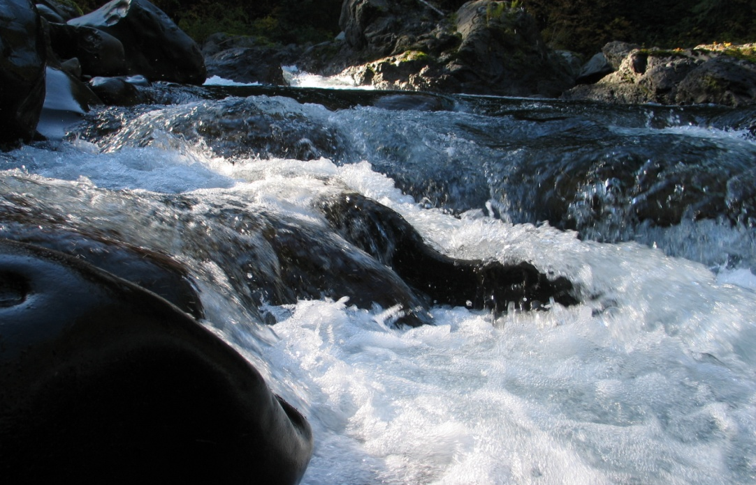
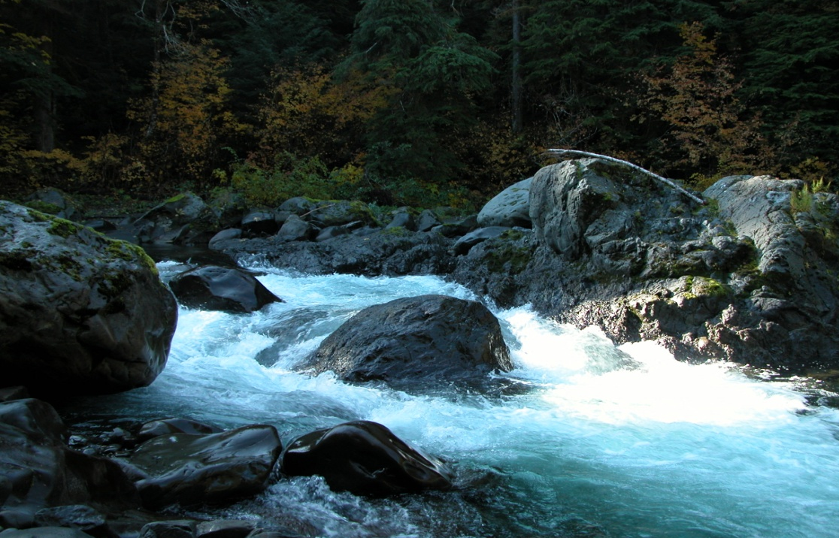
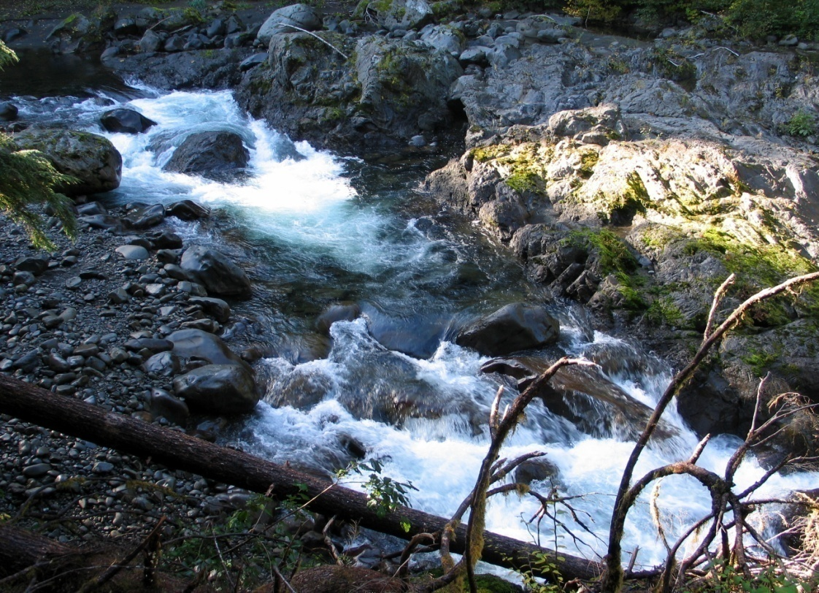
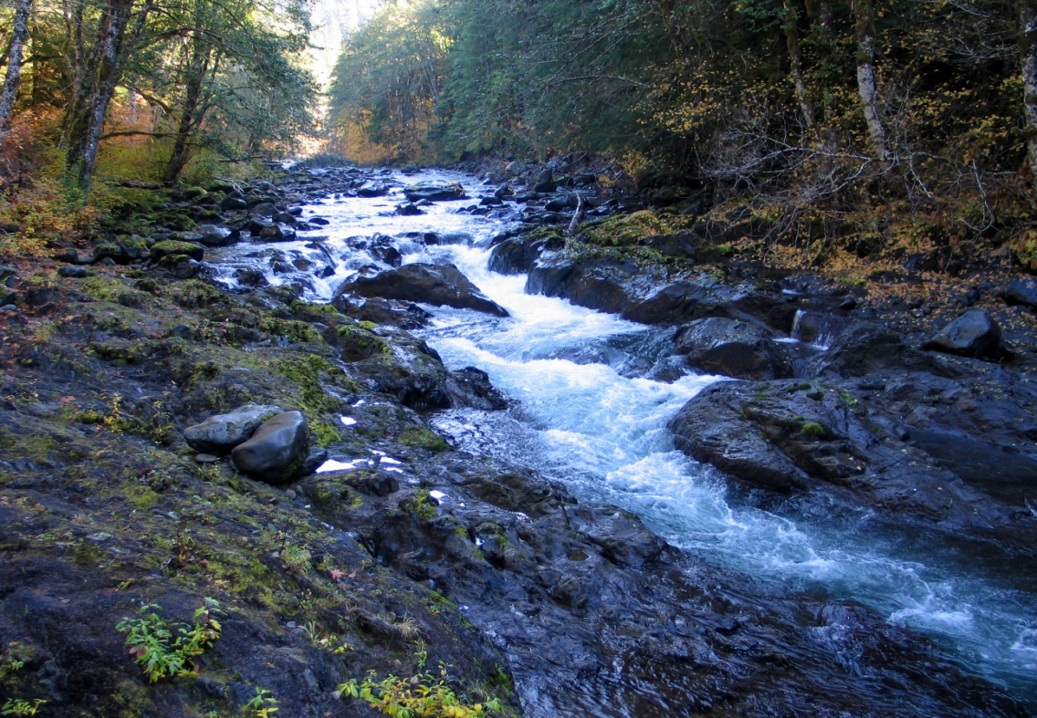
Steep Gradients Form Rapids
Notes:
When rivers flow across a steep gradient, they travel at higher velocities and are capable of rolling large stones and boulders. When they hit steep sections of solid bedrock or piles of large boulders, they tumble over these sections as rapids. This is where white-water occurs. Over time, due to the erosive power of fast-flowing rivers, carrying lots of abrasive sand, gravel, and cobbles, they will erode into the bedrock to form gorges or deep-water channels.

Slide 5
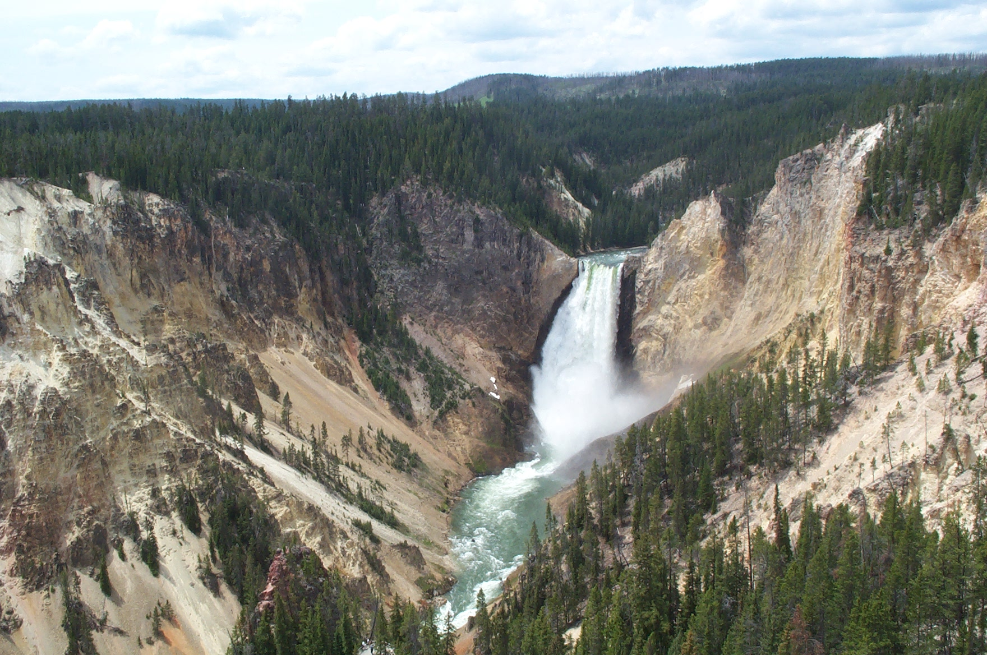
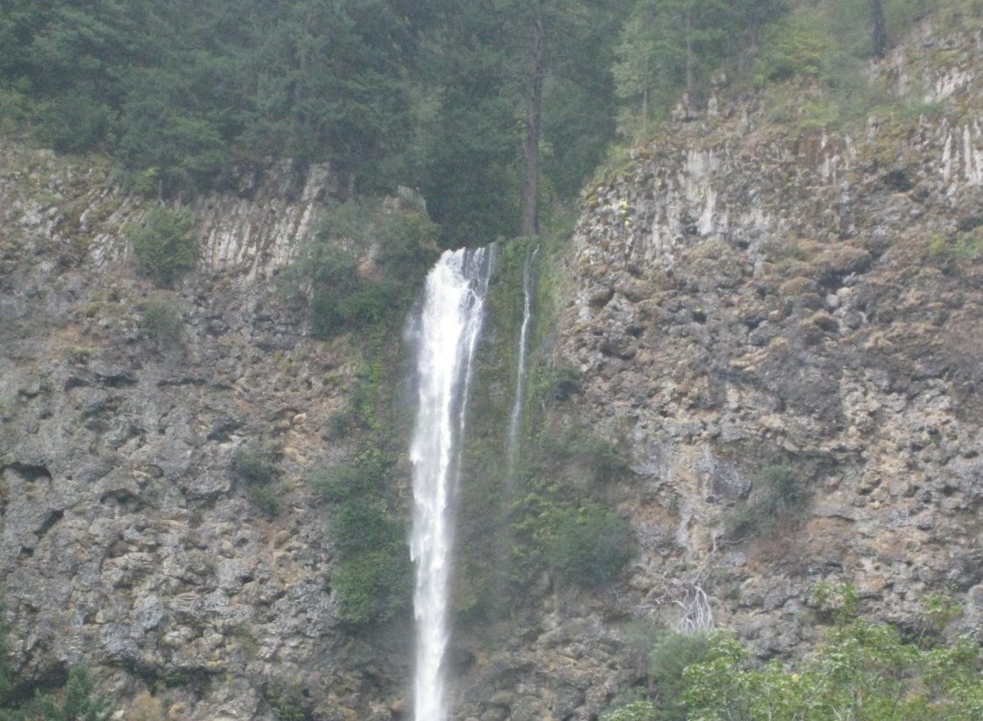
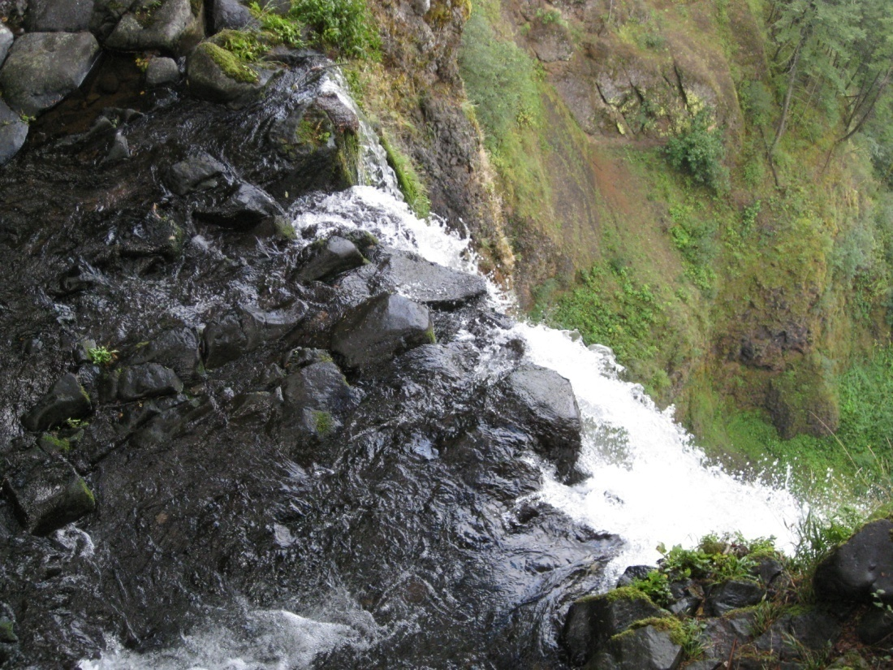
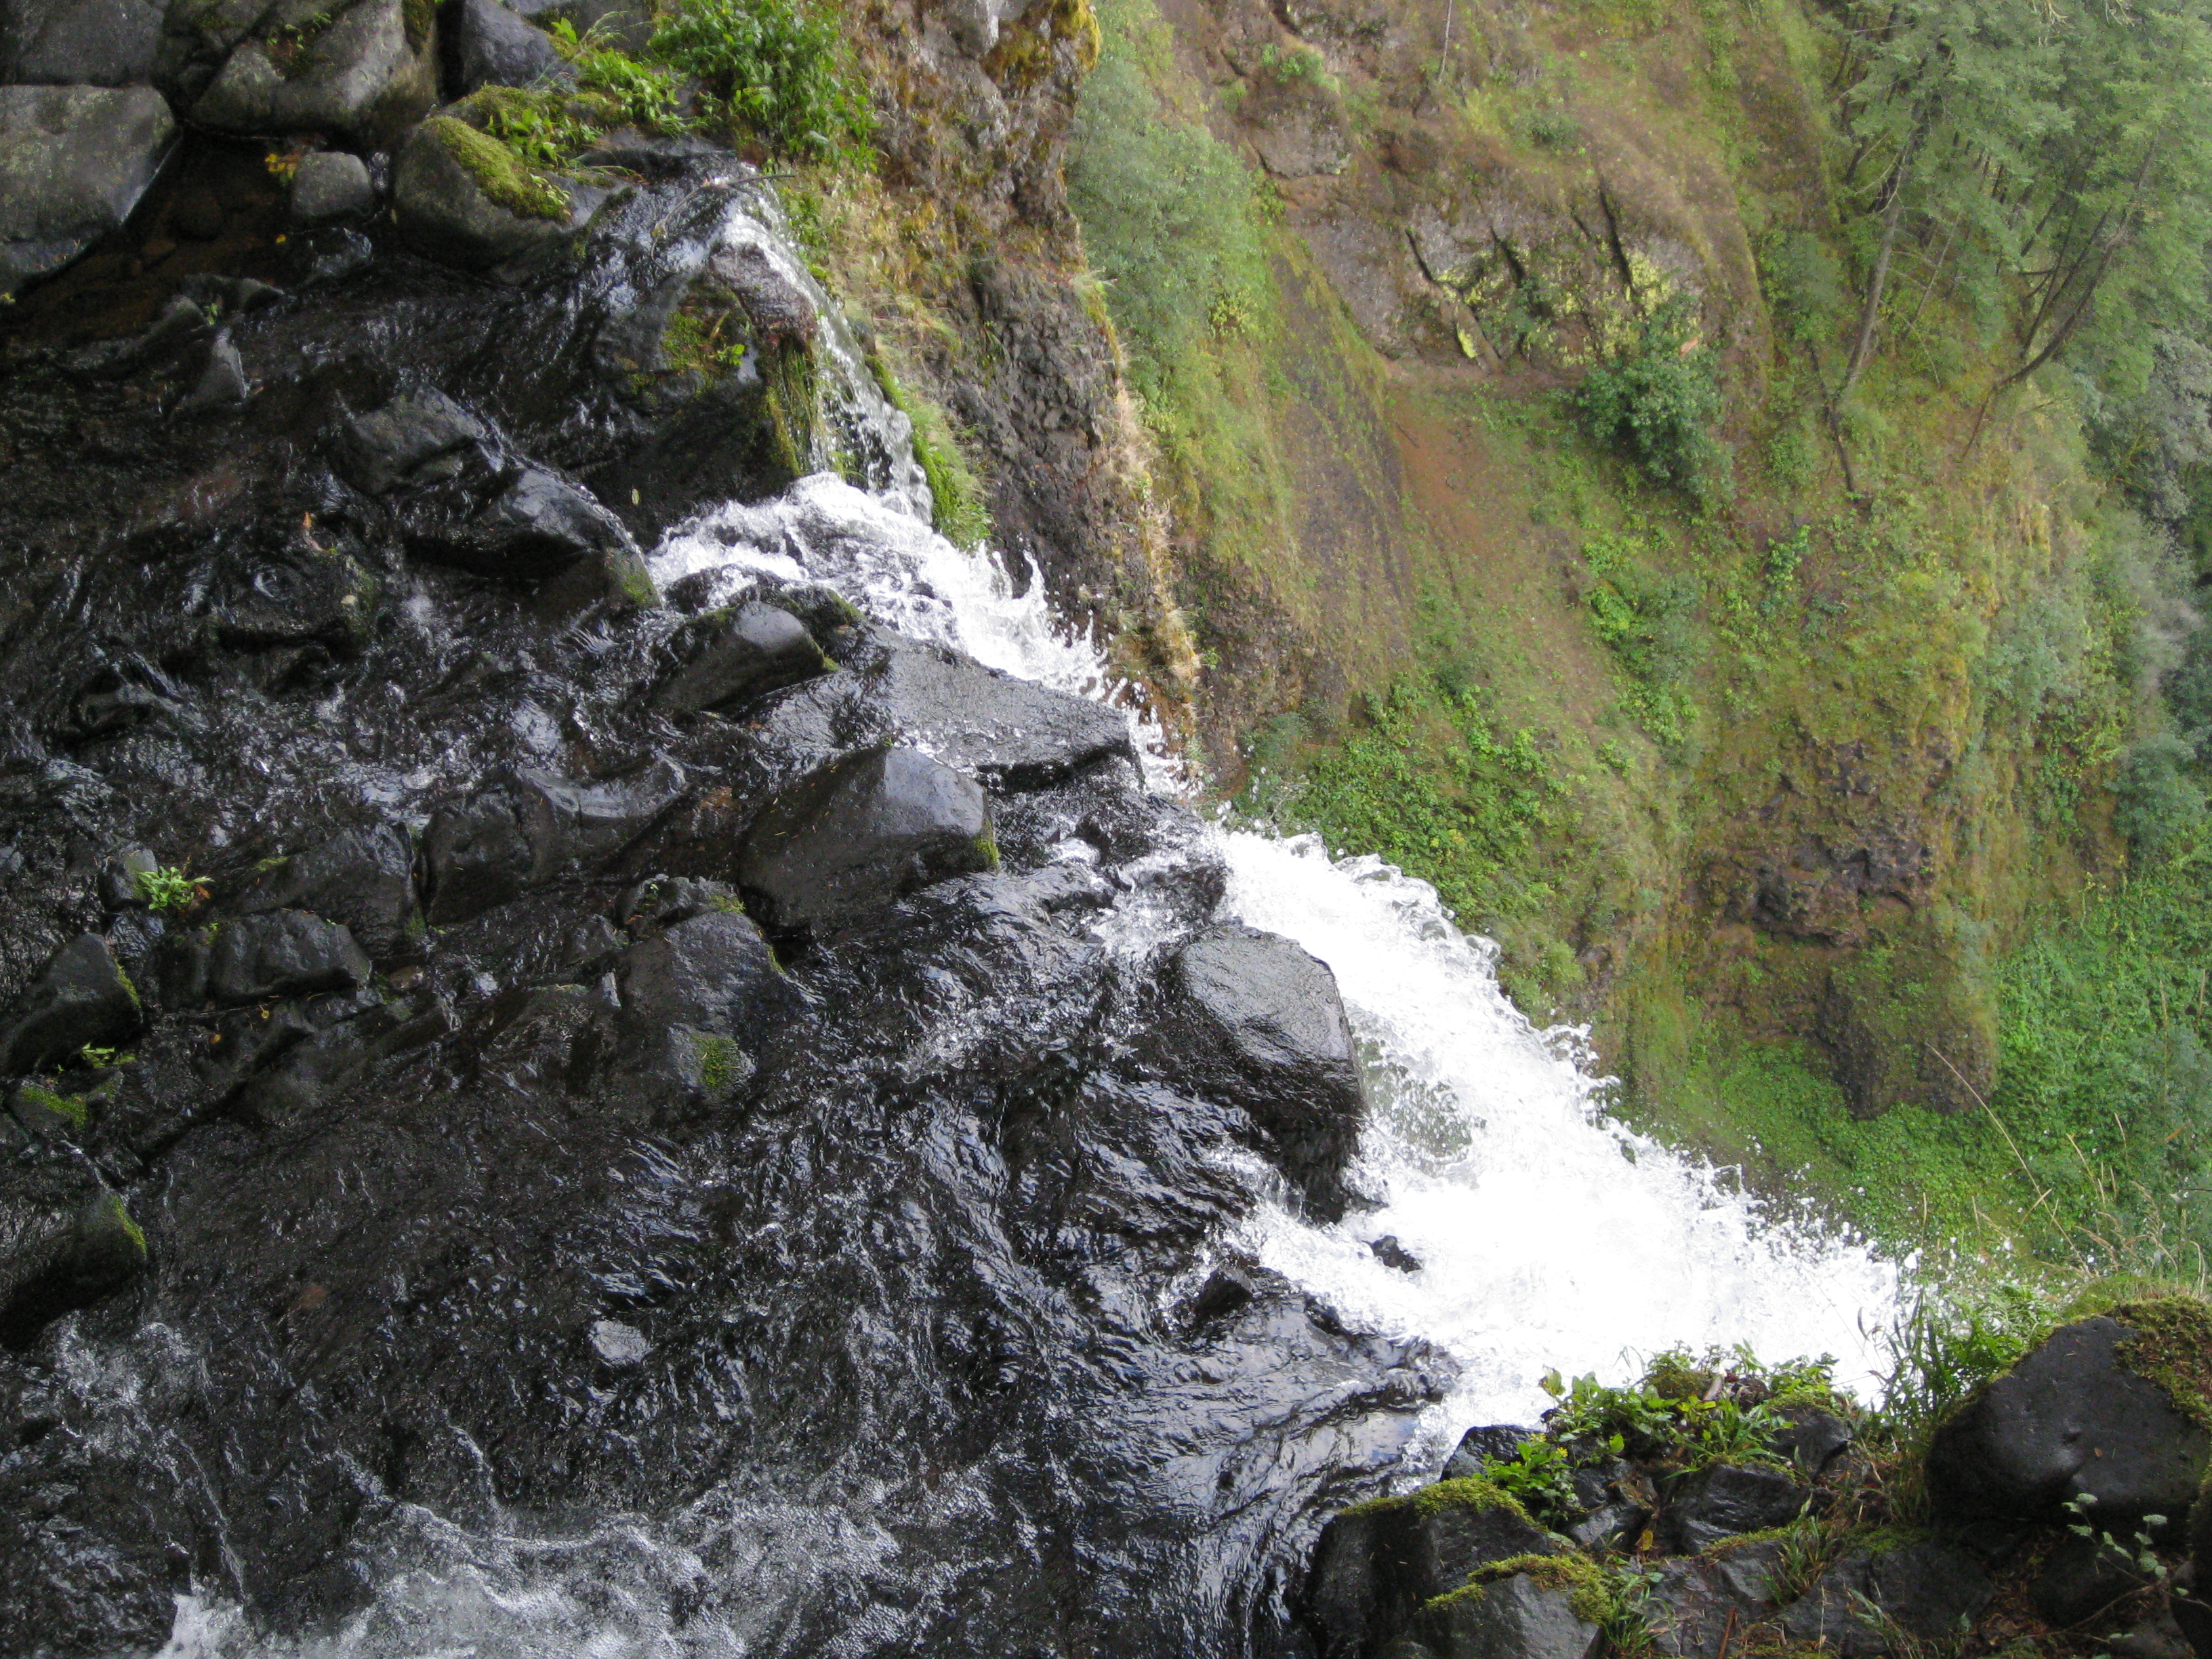
Erosion by Fast-flowing Water
Rapids pluck pieces off the bottom of the river, cutting steeply down into the river bed.
Waterfalls both erode downward and recede upstream as they pluck pieces off the falls.
Notes:
When fast-flowing rivers hit vertical drops, their velocity increases even further and so does its erosive power. As they drop over waterfalls, they erode downward into the rock and recede headward, as they pluck pieces off the edge of the falls. In this image of Multnomah Falls in the Columbia Gorge, you can imagine the rocks at the edge of the falls being the next to be plucked off!
In this image of the Grand Canyon of the Yellowstone, it is easy to see both the down-cutting into the bedrock and the headward erosion, leaving the canyon downstream.

Slide 6
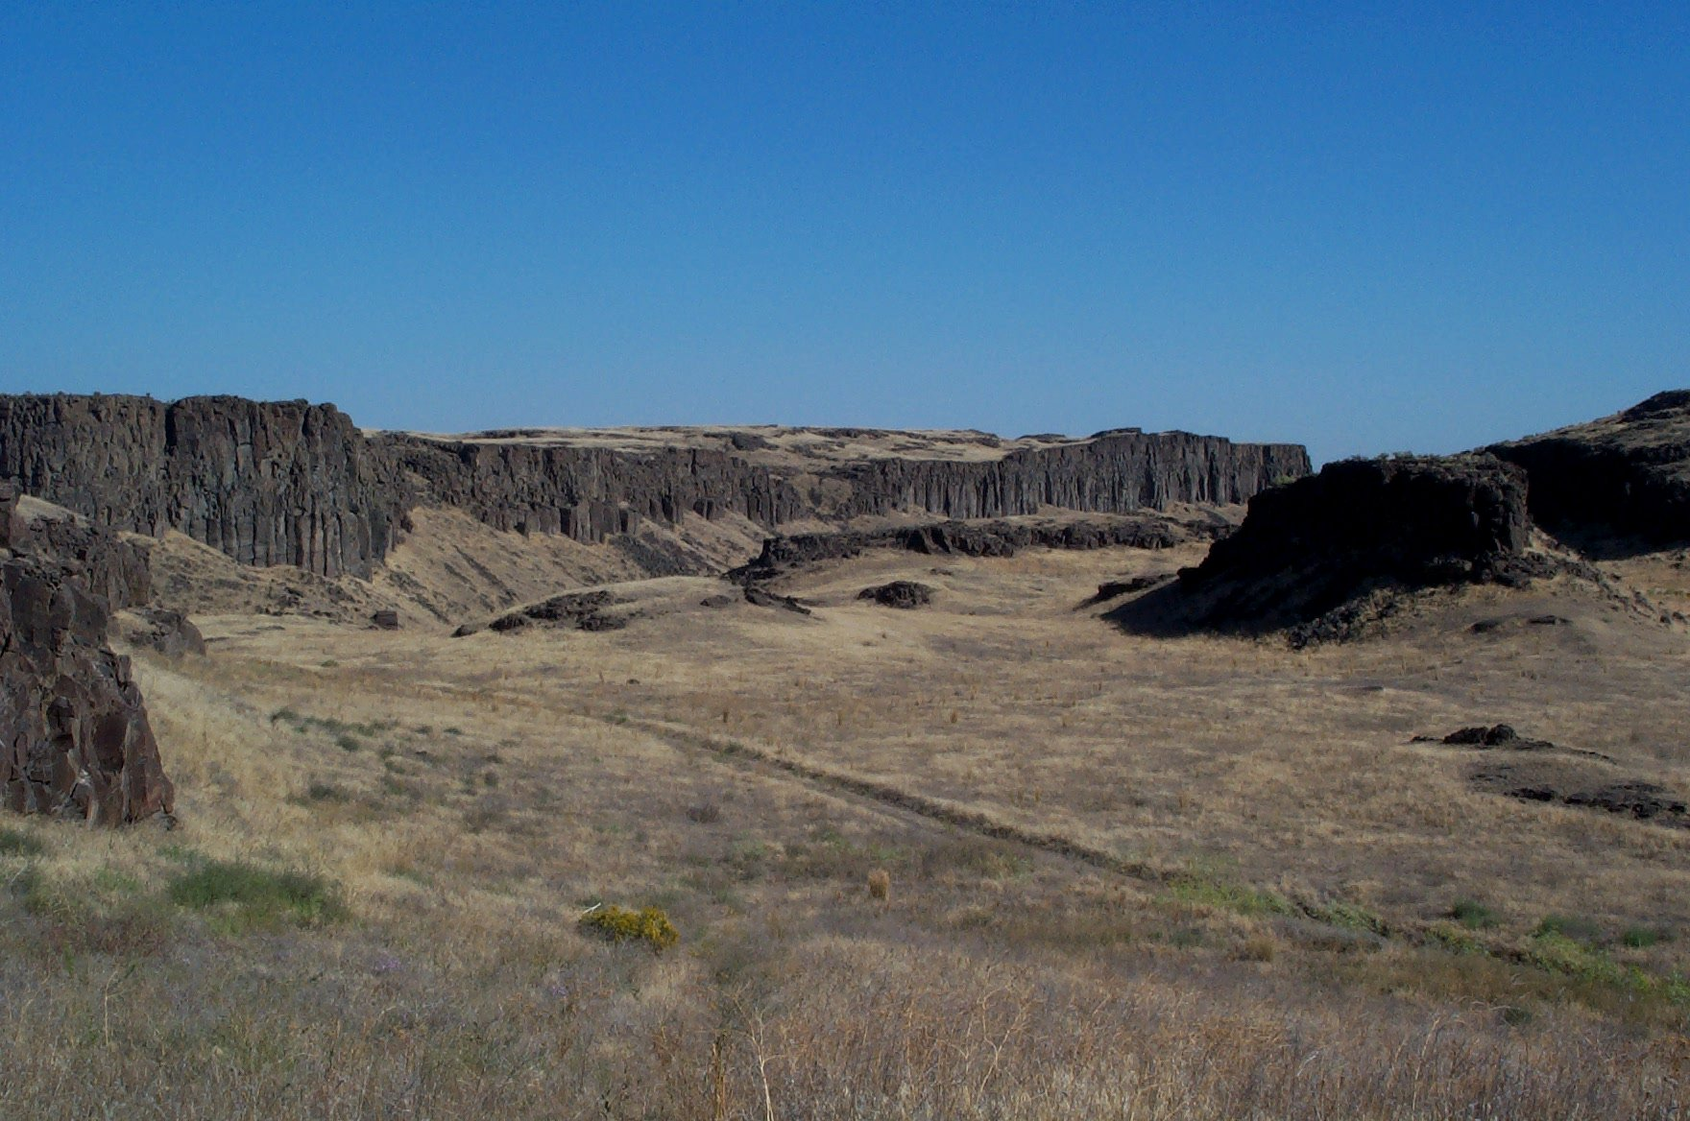
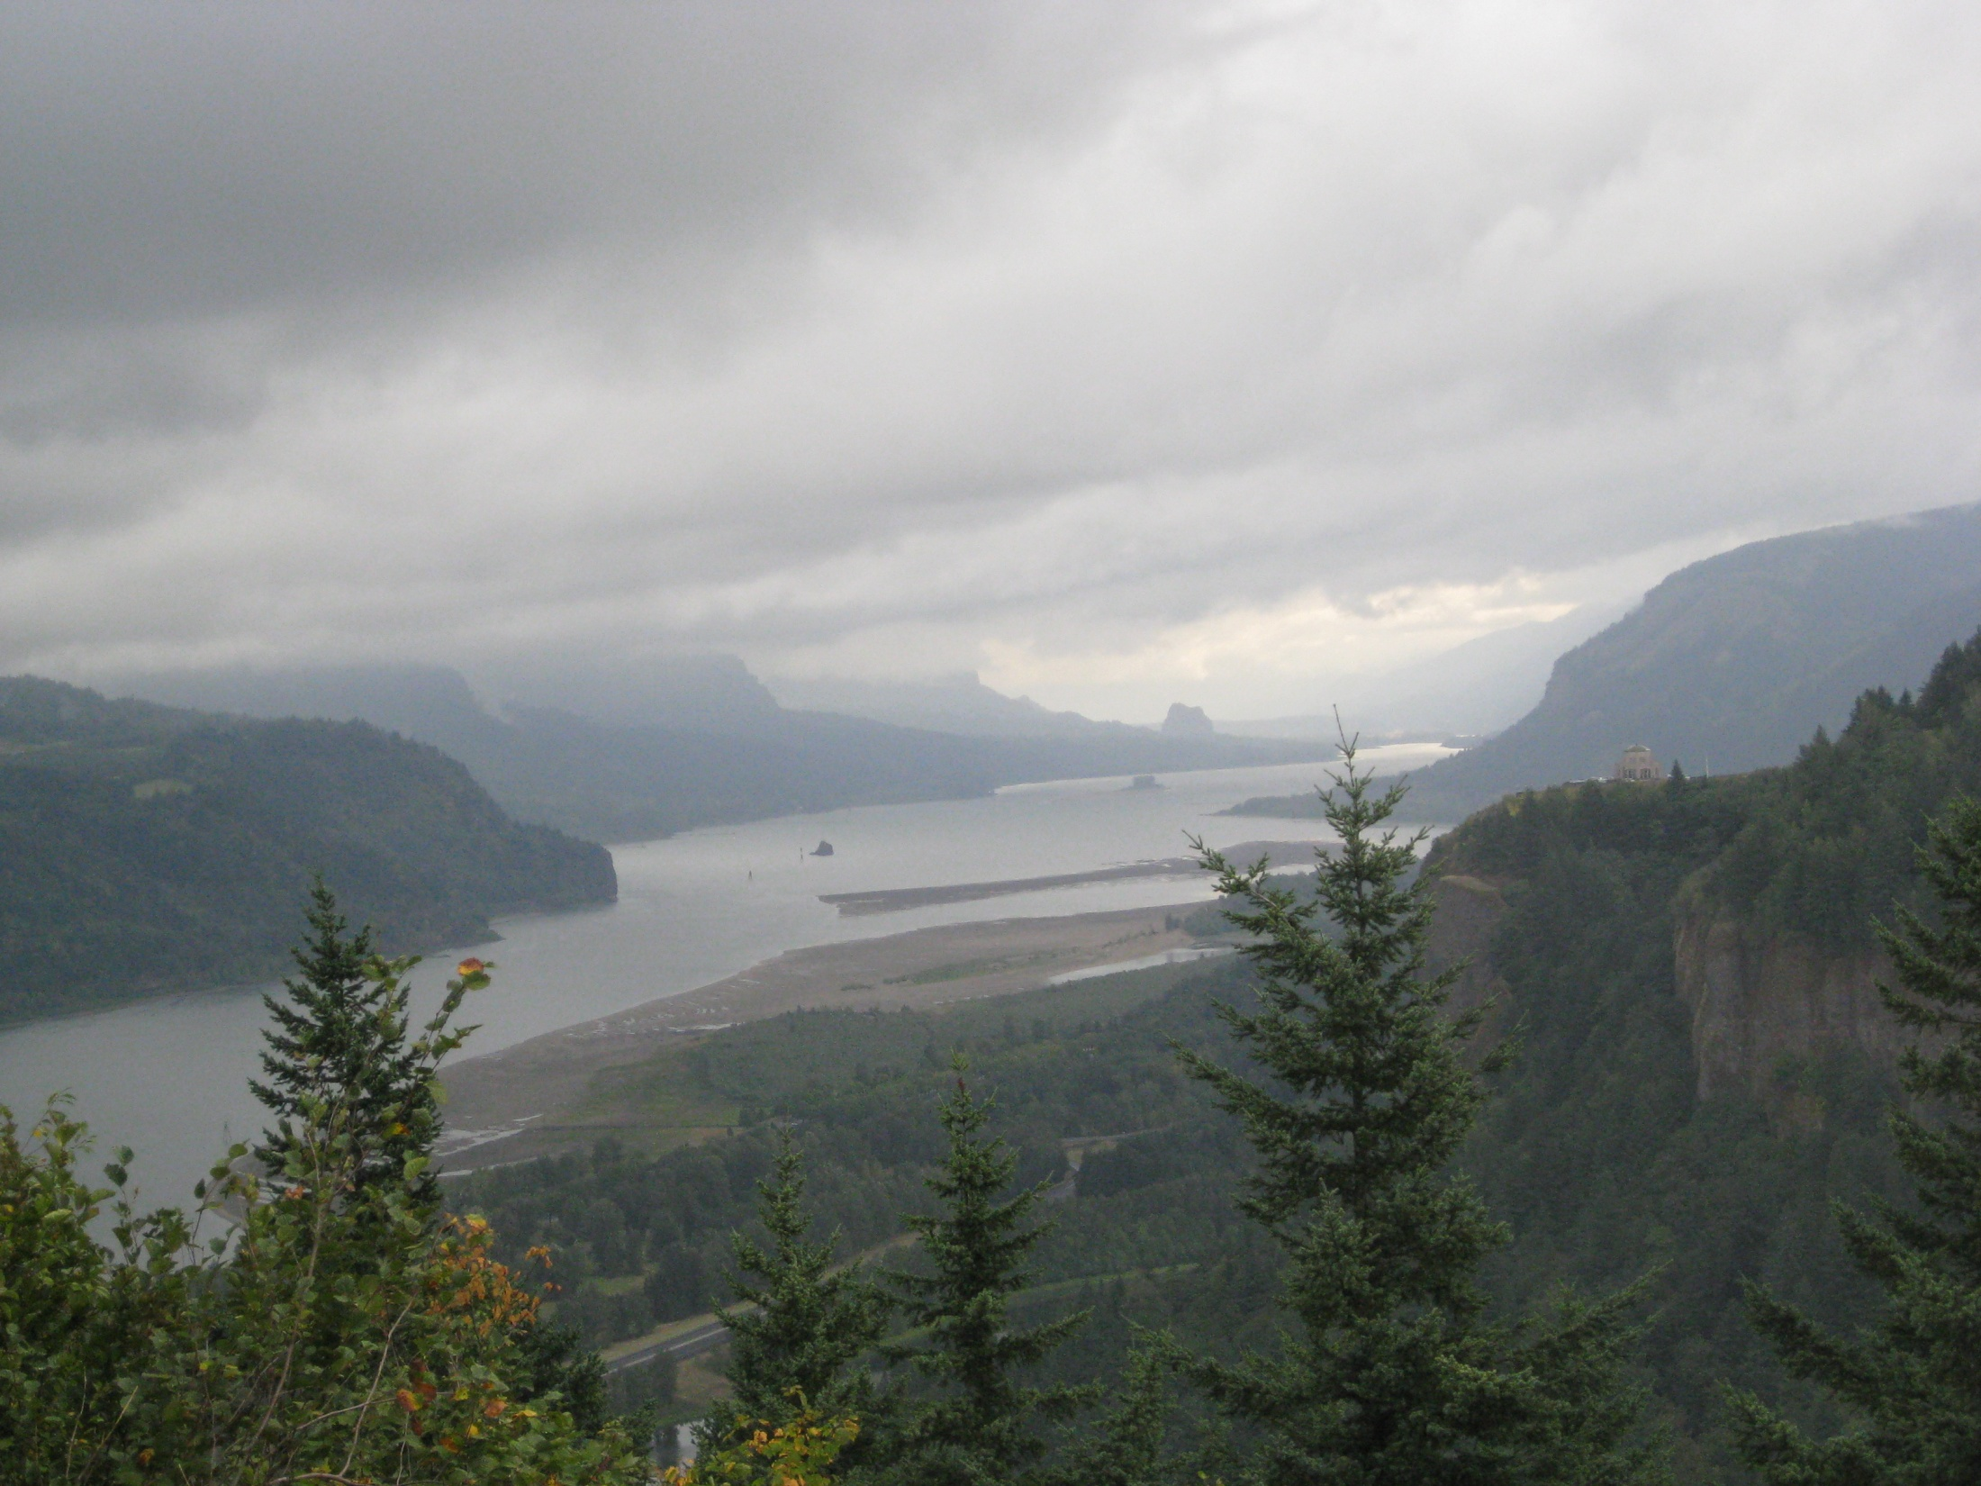
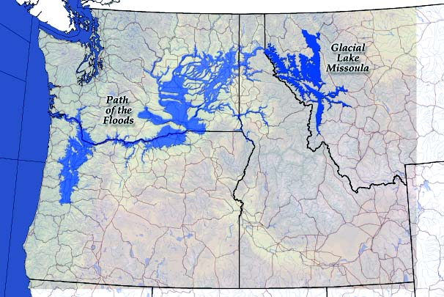
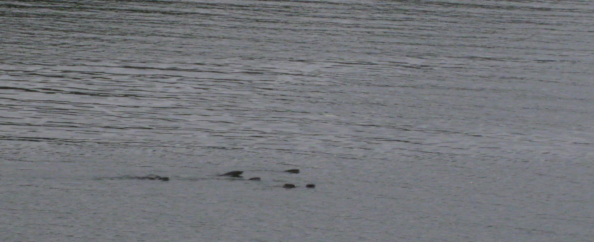
Greatest Floods of All Time?
The Glacial Lake Missoula Floods
Notes:
Near the end of the ice age, a great ice dam from the ice sheets to the north blocked the flow of the Clark Fork River in Montana. As water rose behind this dam, a huge lake formed called Glacial Lake Missoula, which was equivalent in volume to the Great Lakes today. As the climate warmed and this ice dam floated and melted back, the enormous pressure of the lake caused it to rupture and a giant torrent of water washed down across eastern Washington, carving out massive channels and leaving huge boulders across most of the desert. These are floods far greater than anything we can imagine today.
As the water rushed up against the Cascade range, following the Columbia river, it rush through filling the Columbia Gorge up to 700 feet deep. As it entered the flatter Willamette Valley area, it back-flowed to form a great temporary lake. The whole process only took a couple of weeks to drain all of that water.
However, it was not a one time event! As the ice dam broke, it caused the pressure from the great ice sheet to surge forward, damming the river again and forming a new Glacial Lake Missoula. This process repeated itself over and over again. It is estimated that there were some 40+ glacial floods over a 2,000 year period near the end of the ice age, until the entire ice sheet melted away permanently. However, based on the lake shorelines in Montana, it appears each filling was lower than the ones before, because the ice dams tended to be lower each time as the ice age ended.
The first image shows what the Columbia Gorge might have looked like when filled with 700 feet of surging brown water. The cliffs are over steepened, due to the erosive forces of the floods plucking rocks from the sides and leaving dozens of hanging valleys, where many waterfalls, including Multnomah Falls drop today.
The next image shows the channeled scablands of eastern Washington, where torrents of water carved these deep channels, now called coulees.

Slide 7
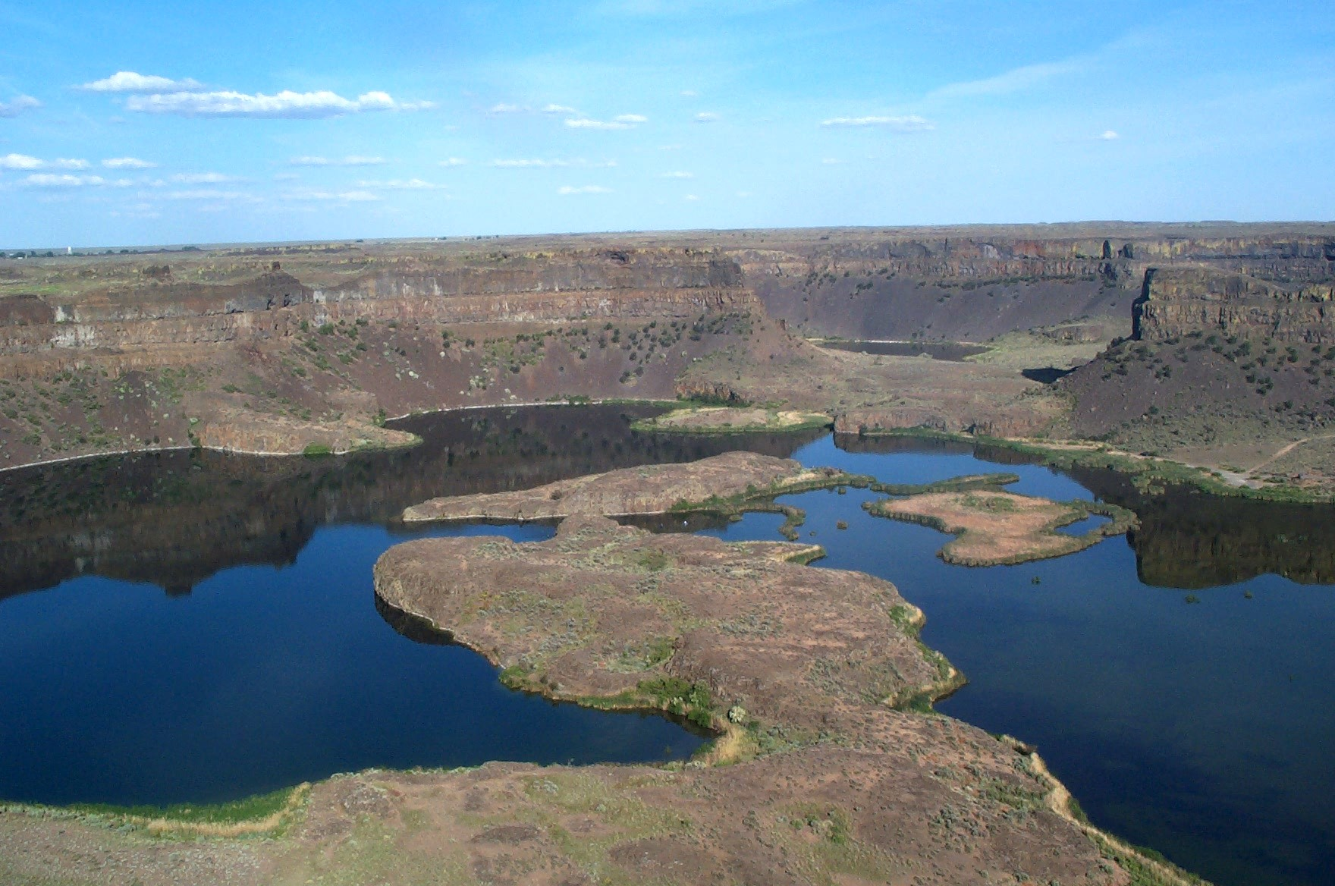
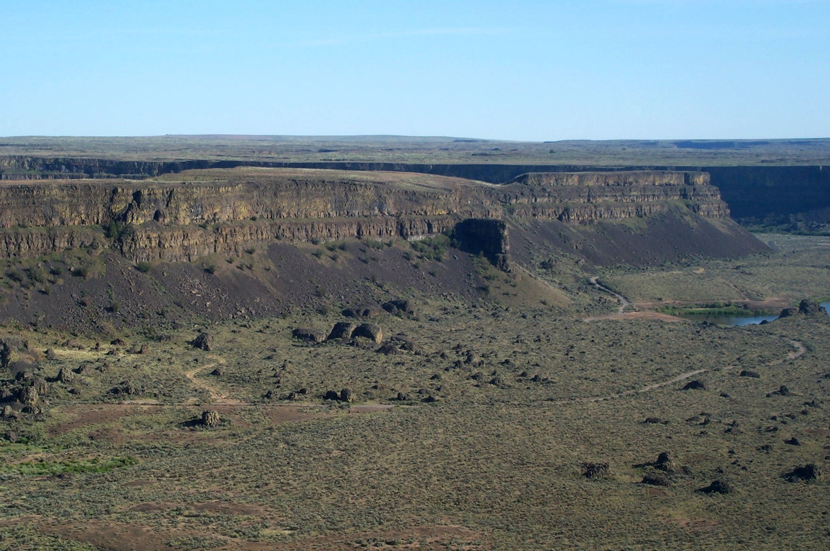
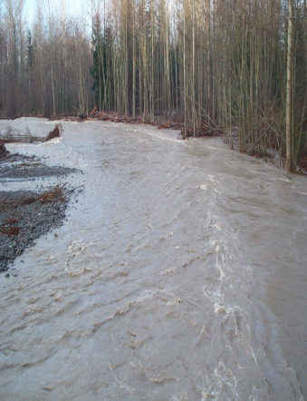
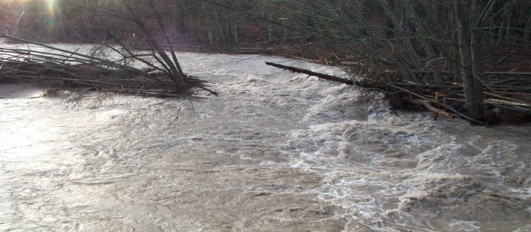

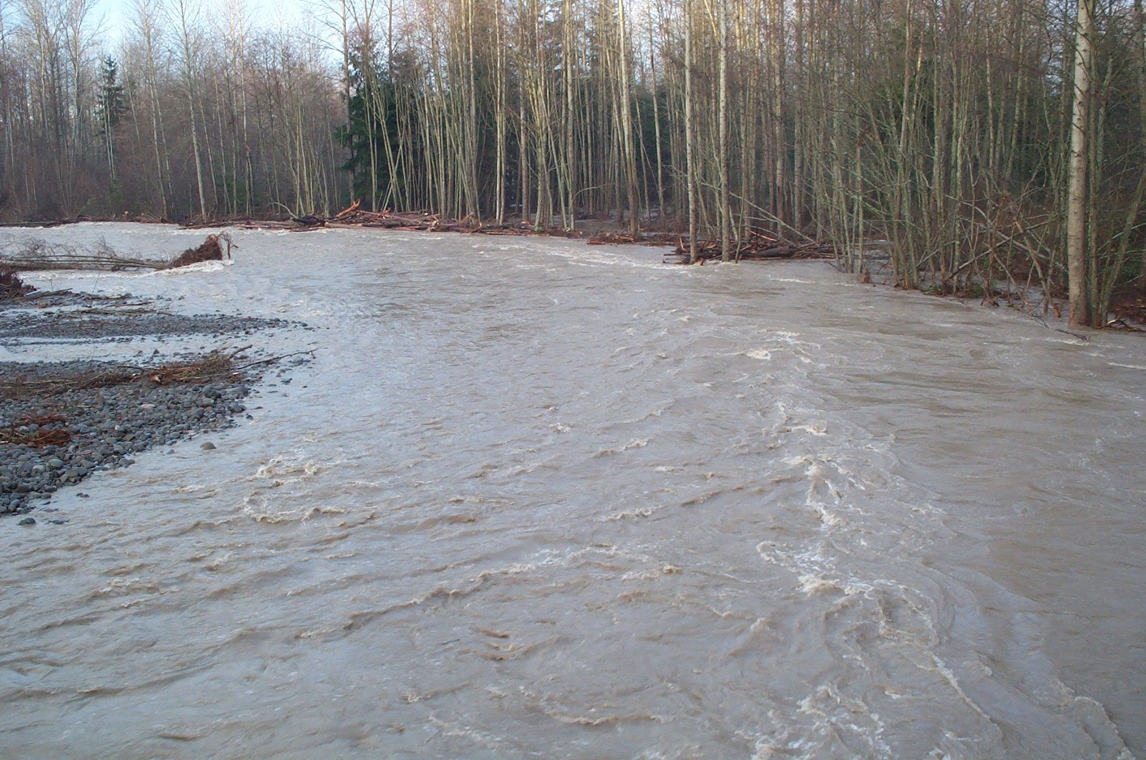

Evidence of Massive Waterfall Recession
Notes:
This is Dry Falls in eastern Washington, formerly a massive waterfall that formed during the torrential Glacial Lake Missoula Floods 12,000 years ago. It easily would have dwarfed Niagara Falls in terms of width, height, and volume of water. The pools below are the deep plunge pools that formed where formed by the falls. You can see the side areas that receded back.
In the next photo, you are looking downstream from the falls where the deep canyon was formed by headward erosion. The huge boulders on the bottom were river-rounded rocks that tumbled along the “riverbed”, much like a normal river would do to small rocks today. Only this occurred on a massive scale. For scale, look at the size of the road below compared to the rocks at the bottom. These make a car look tiny!

Slide 8
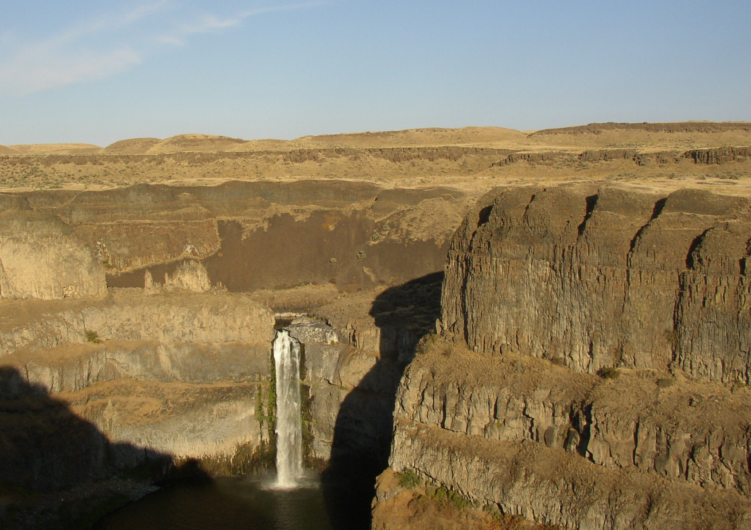
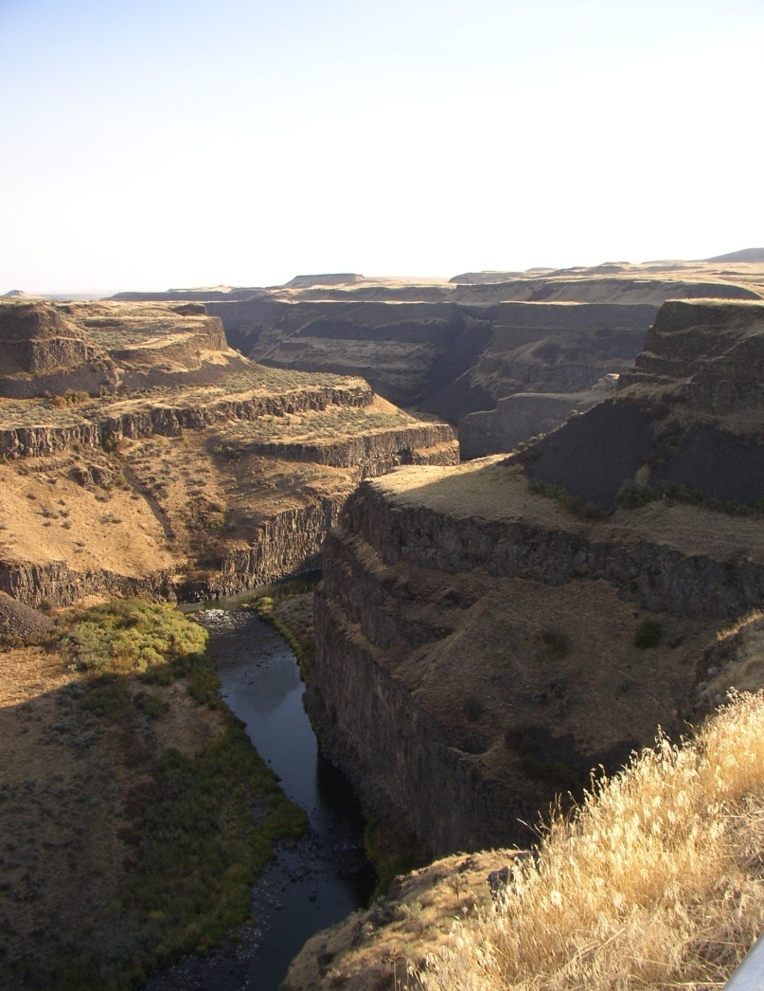
Plucking and Recession on the Palouse River
Notes:
This is another place where plucking and headward erosion is obvious. This is Palouse Falls in eastern Washington. The falls have cut into the rock well below the canyon rim. Downstream, this narrow canyon was cut by headward erosion for miles by the Glacial Lake Missoula floods.

Slide 9
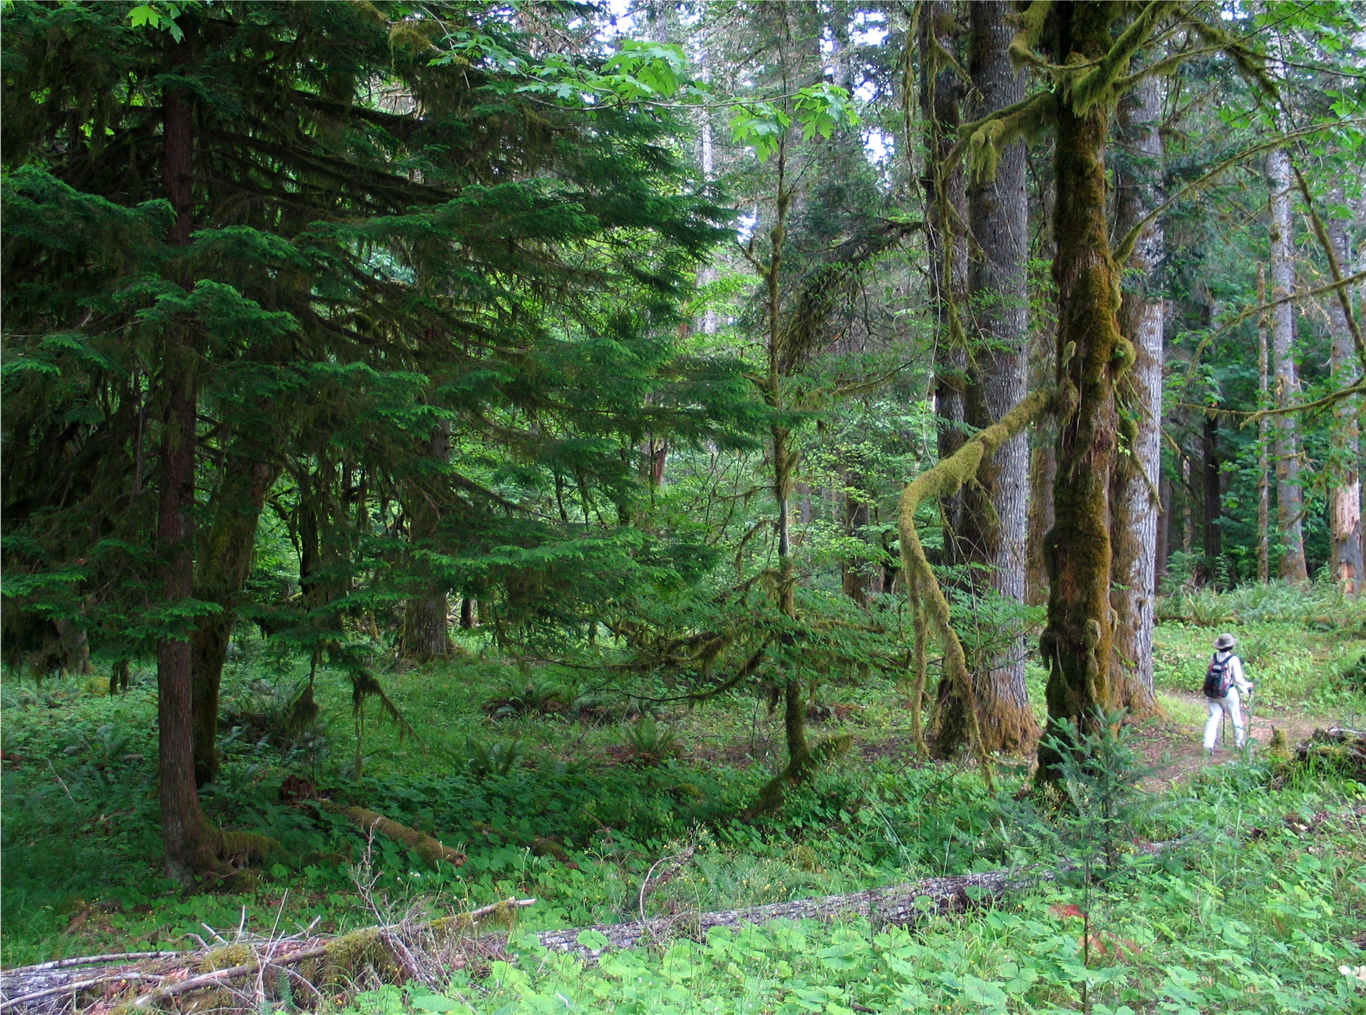
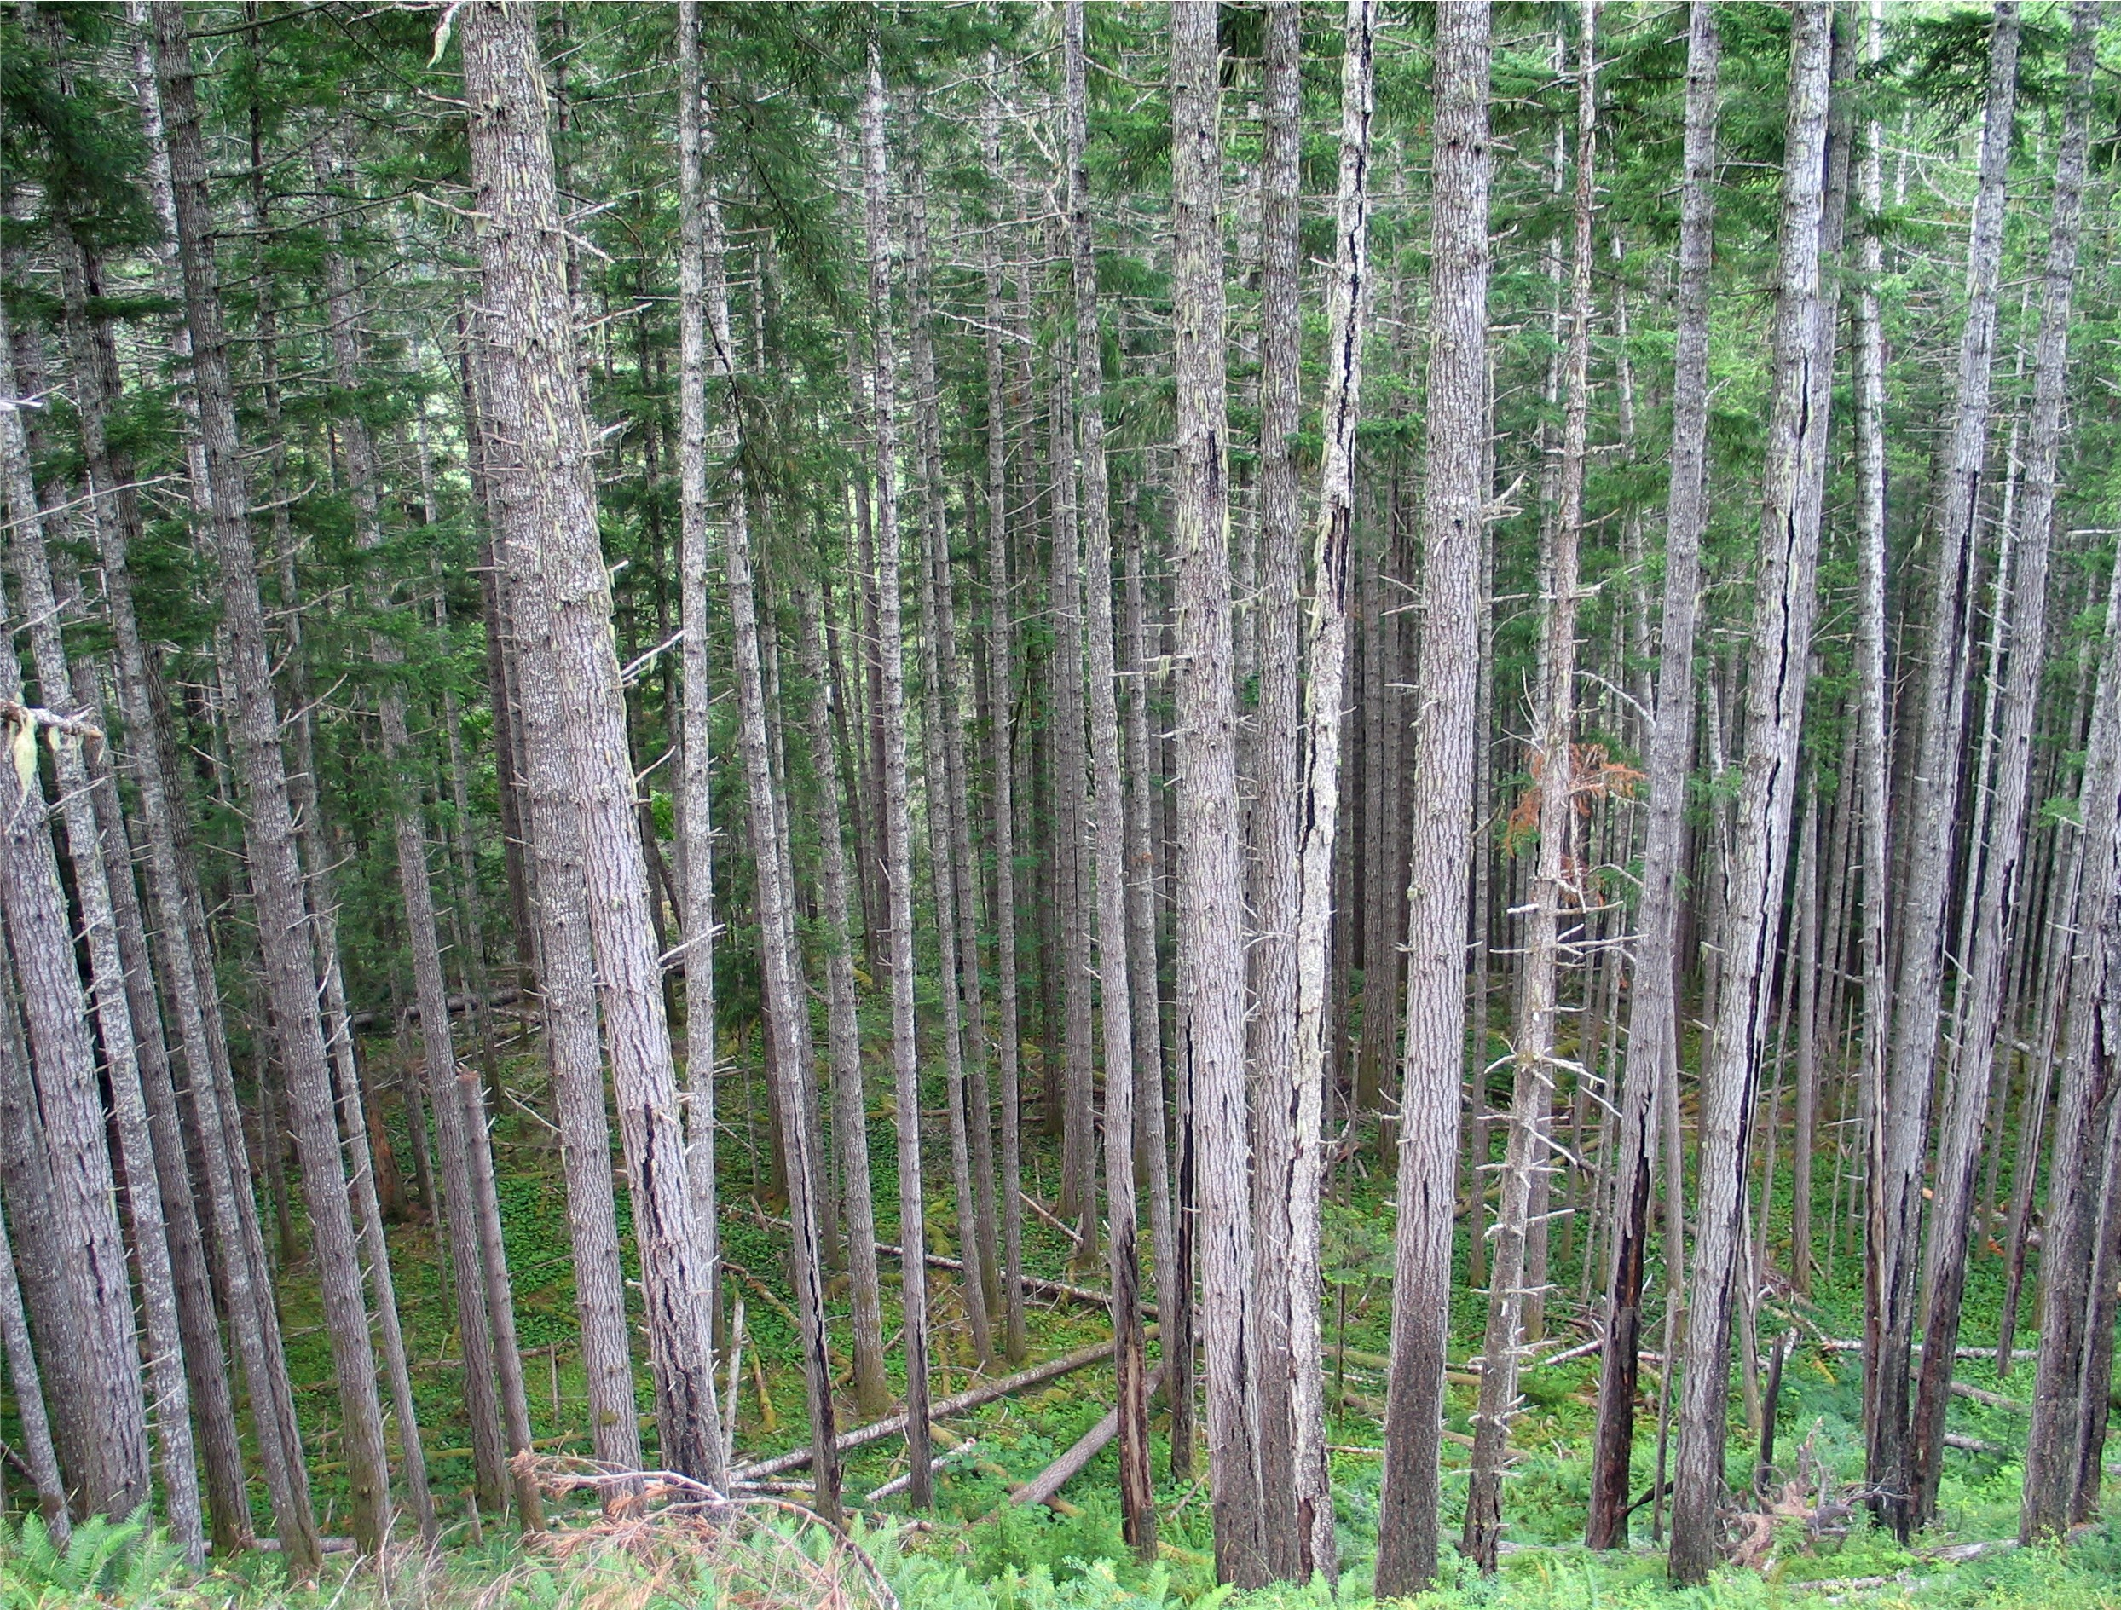
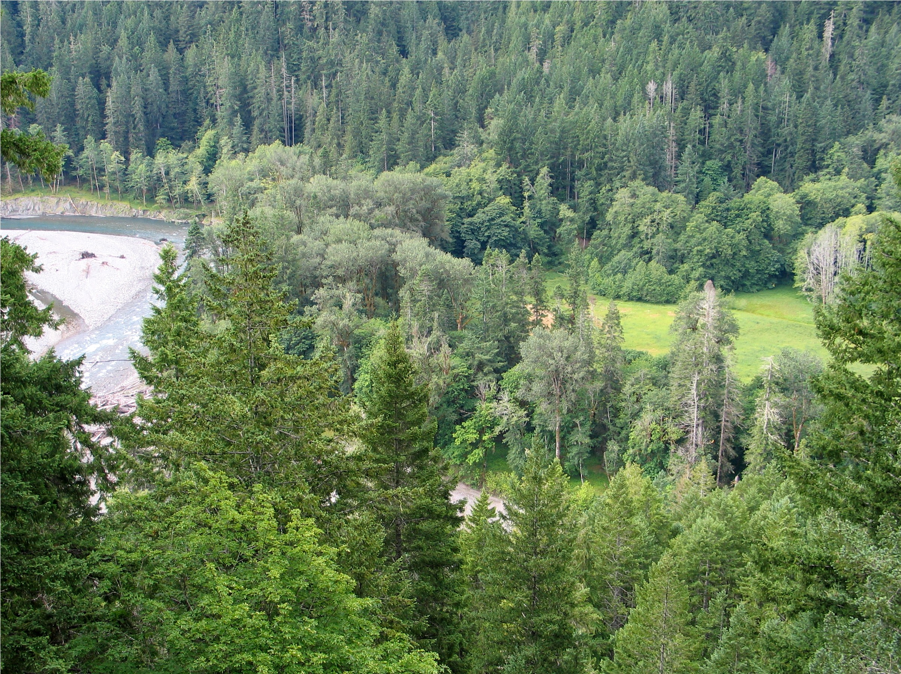
Terraces/Benches
Terraces
Notes:
As fast-flowing rivers cut into the bedrock, they constantly dig deeper into the valleys. As they meander back and forth across the flood plain, they can create flats in places at the bottom of the valley. But, at some point, whether it is due to flooding or reaching easier to erode bedrock, they will cut a deeper channel below the floodplain and leave the terrace above for good. These former river beds contain the old rounded cobbles as evidence of the former river bed, but are elevated above the current river. There are often a whole series of these benches rising hundreds of feet above the river. Often, it was these terraces where homesteaders built their cabins and settled in otherwise steep mountainous terrain.

Slide 10
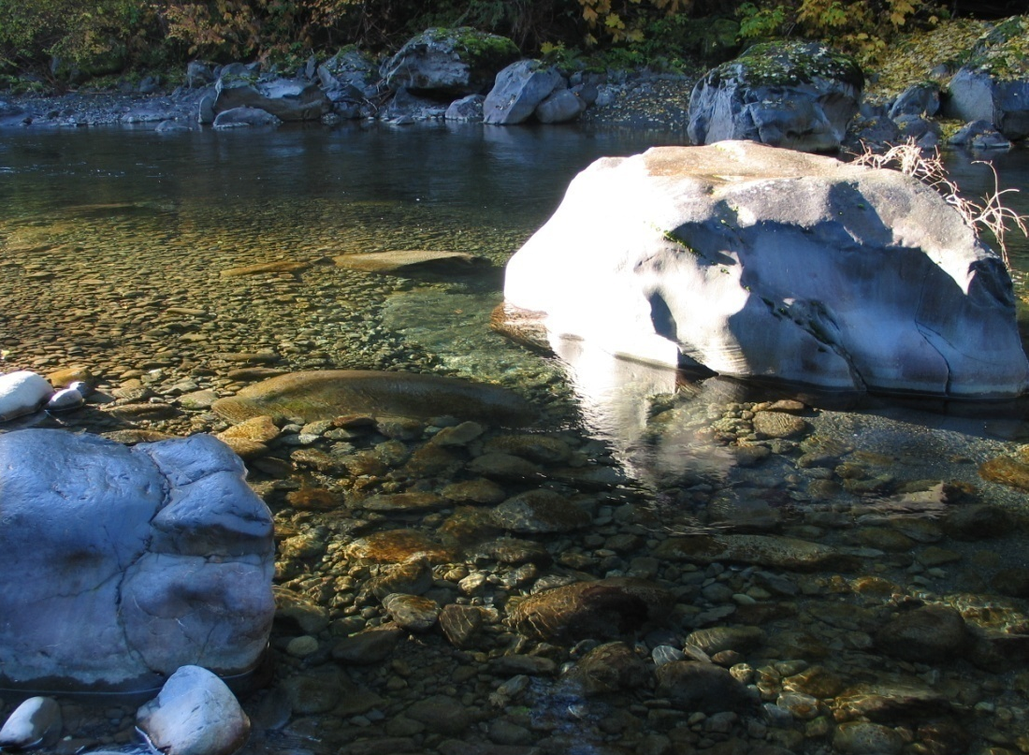
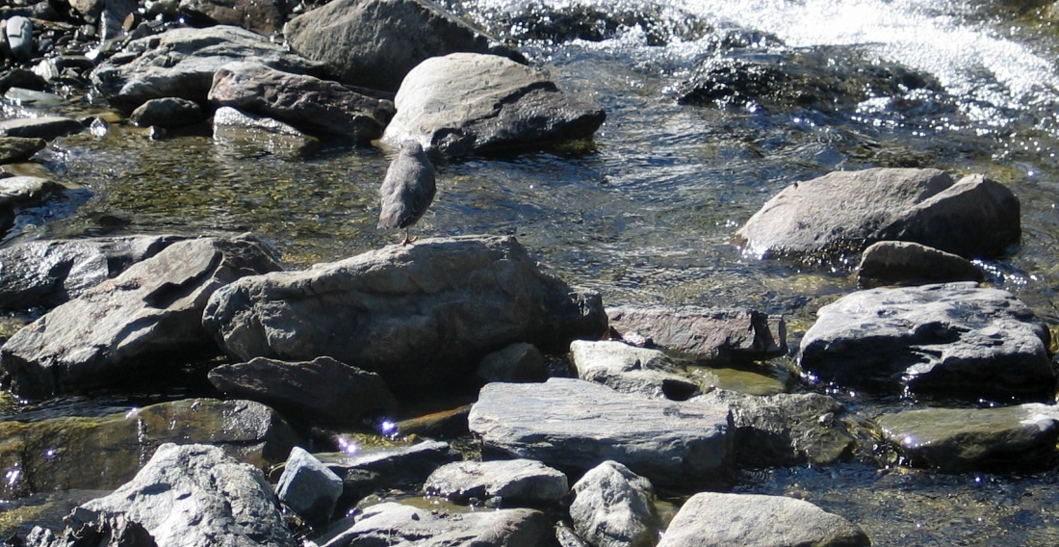
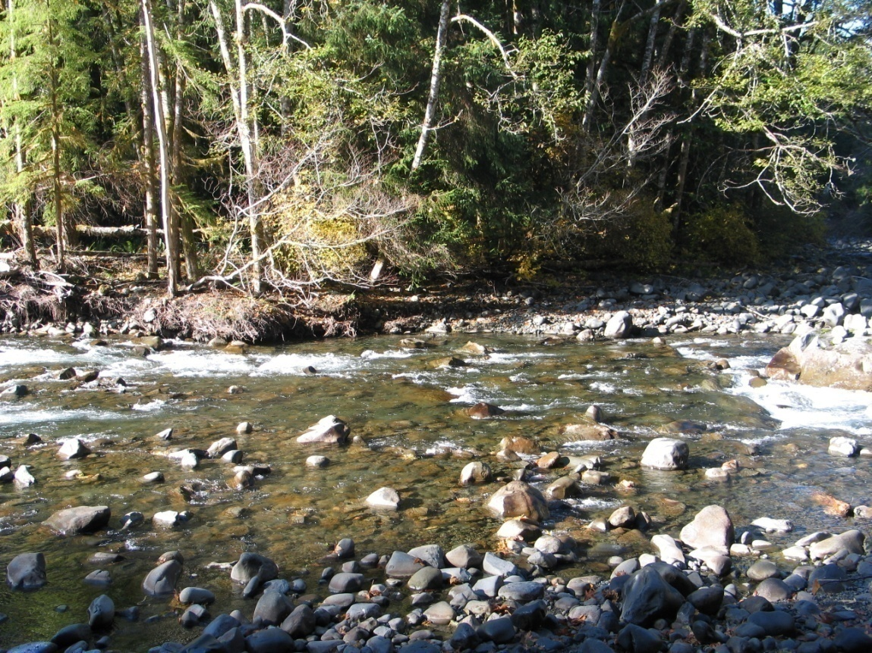
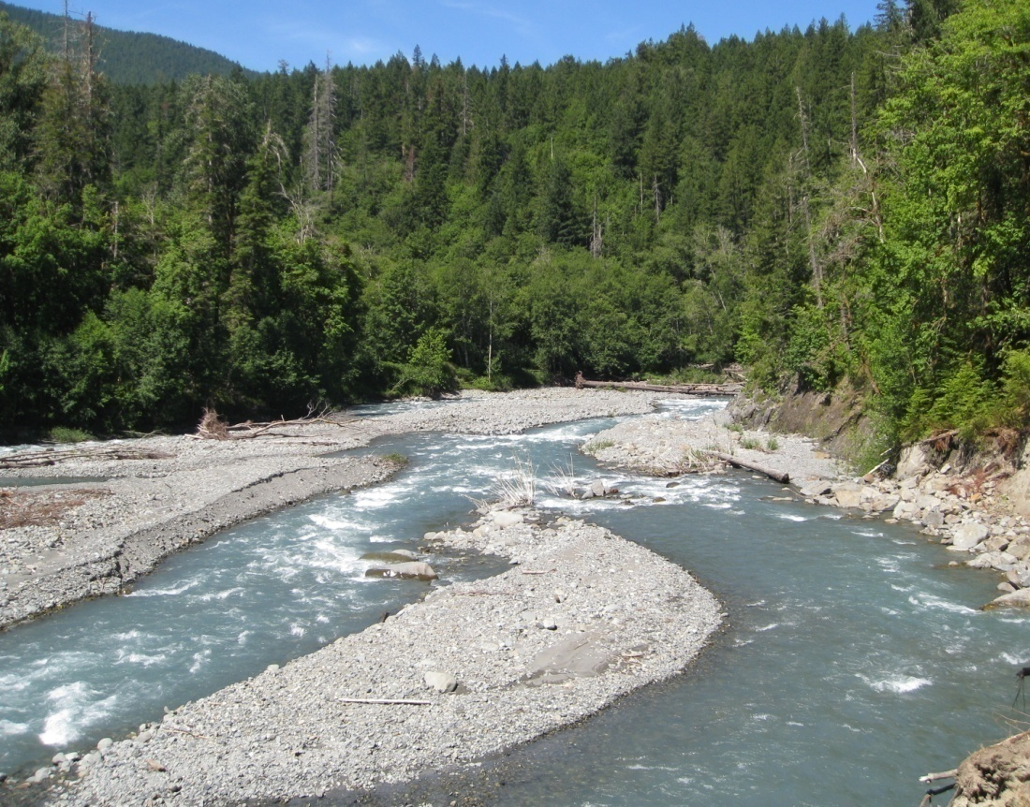
Cobbles and Stones
Notes:
Swift-flowing rivers are capable to rolling larger stones and medium-sized cobbles. When rivers flow rapidly, such as during flood events, these stones can roll quite far. Often during the low-flow summer season, they are stationary and form cobble bars. In winter, these bars will become submerged and often change shape. The cobbles become rounded over time by abrasion of smaller sediments (gravel and sand) and by tumbling along the bottom.

Slide 11

Thanks to Washington’s National Park Fund
This project was made possible in part by a grant from
Washington’s National Park Fund.

